Slide 1

REPORT BY :>>
NAME >>ANKUR SINGH
REG.NO >> 12112543
PROJ.NO >>31
ROLL.NO>>RK21BGB95
SECTION>>K21BG
LINK>>https://github.com/Ankur050/CSE326-STAMP-SITE-12112543.git

Slide 2

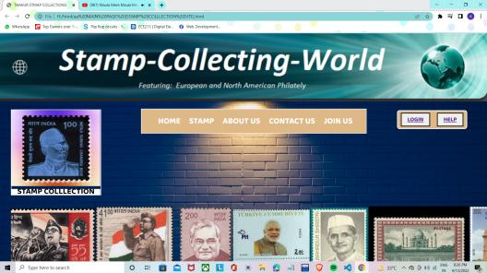
Main page::
>> It is homepage of my website.
>>From here you can download or see the stamps.
>>Tags used::html,head,link,style,body,div,ul,a,href,
Bgcolor,cursor,hover,position,margin,padding,marquee,etc.

Slide 3
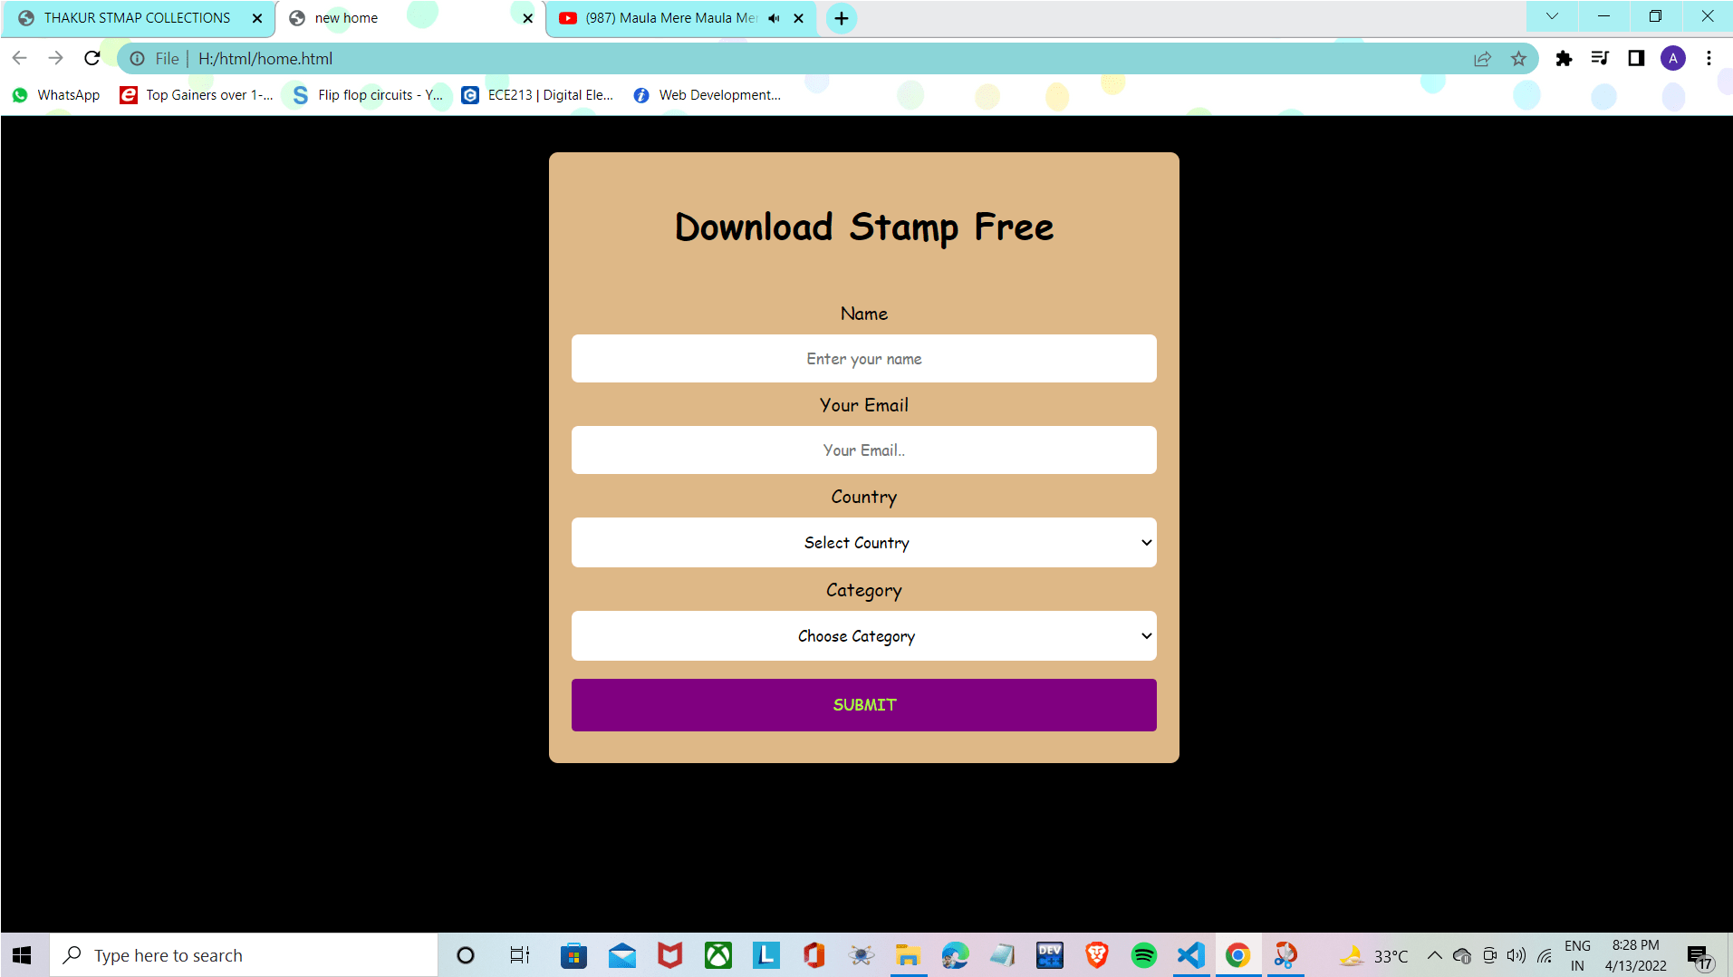
Download page
Tagused::>>body,fontfamily,align,level,option,value,select,
placeholder,select,div,h1,bgcolor,href ,padding ,margin,left,top,etc

Slide 4
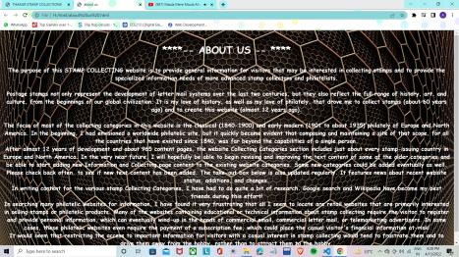
About us >>
Tag used>>html,head,title,font size,h1,p,h3,bg color,img src ,etc.

Slide 5
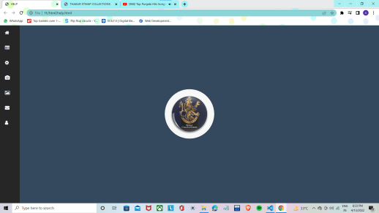
Help::>>
Tag used ::>>html,head,title,bg-color, fontsize,padding ,margin,
div,href,img src,position,border radius,font family,font weight,left,
top,cursor,etc

Slide 6
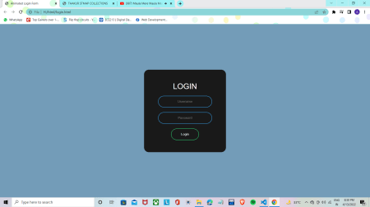
Login page::>>
Tag used ::placeholder,value,input type,padding ,margin,border,bg-color,form,etc.

Slide 7
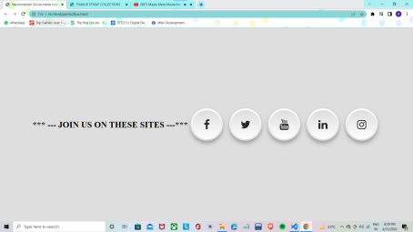
JOIN US
TAG USED ::>>anchor, href, border radius,padding , margin,font color,font family,etc

Slide 8


